Slide 2
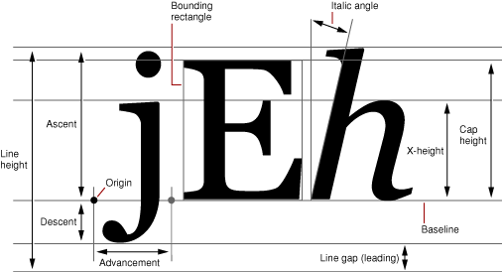

Slide 3
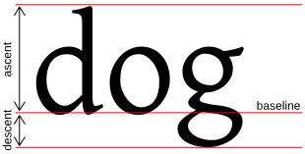

Slide 4
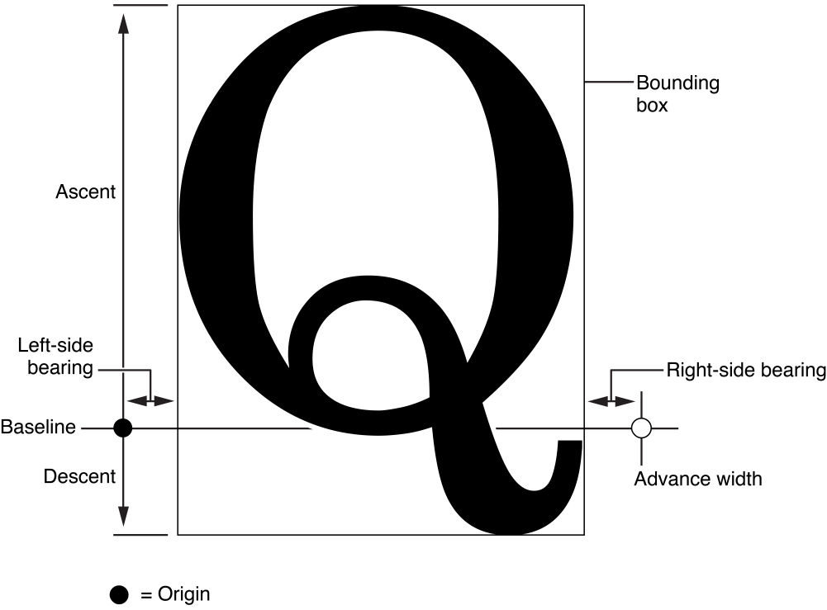

Slide 5
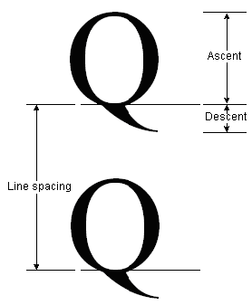

Slide 6
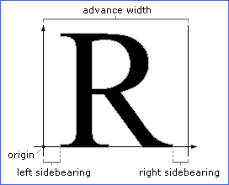

Slide 7
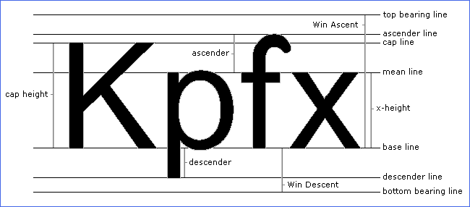

Slide 8
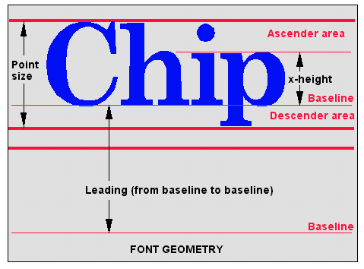

Slide 9
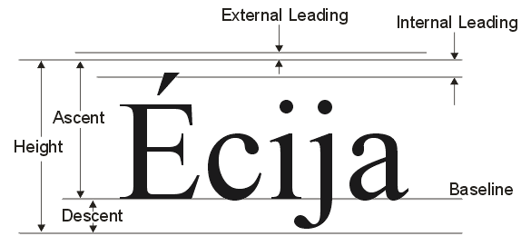

Slide 10
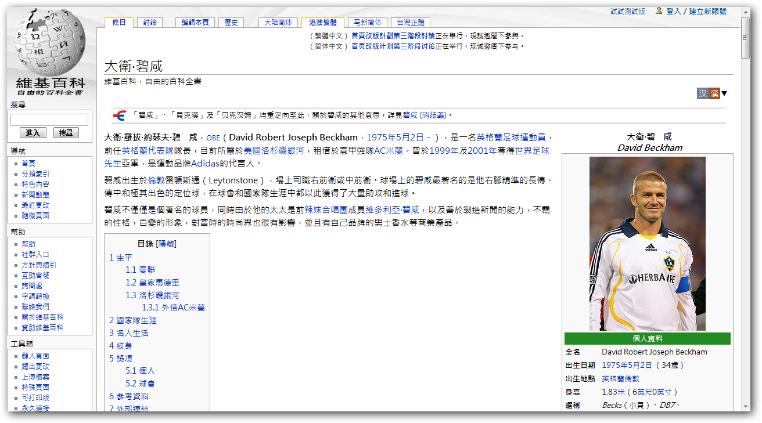
微软正黑体 Microsoft JhengHei
碧咸,筵席
碧咸,筵席

Slide 11
Typography
Typography is the art and technique of arranging type to make written language readable and beautiful.
The arrangement of type involves selecting typefaces, point size, line length, line-spacing(leading), letter-spacing(tracking), and adjusting the space within letter pairs(kerning).

Slide 12
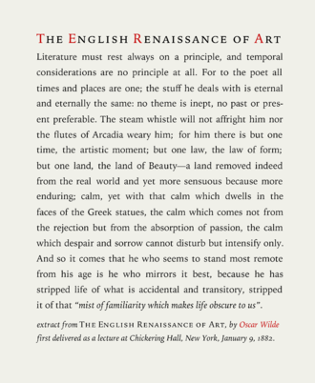
Typography
Text typeset in Iowan Old Style roman, italics and small caps, optimized at approximately 10 words per line, typeface sized at 14 points on 1.4 × leading, with 0.2 points extra tracking. Extract of an essay by Oscar Wilde The English Renaissance of Art c. 1882.

Slide 13
Typeface

Slide 14
Font
In metal typesetting, a font is a particular size, weight and style of a typeface, and a typeface comprised a range of fonts.
In modern usage, with the advent of digital typography, “font” is frequently synonymous with “typeface”.

Slide 15
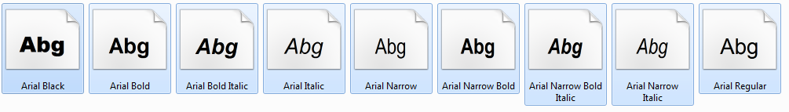
Font
Font & Typeface
For instance, the typeface “Arial” may include the fonts “Arial Black”, “Arial Bold” and “Arial Narrow”, but the term “font” might be applied either to one of these alone or the whole typeface.

Slide 16
Font characteristics
Weight
The weight of a particular font is the thickness of the character outlines relative to their height
A typeface may come in fonts of many weights, from ultra-light to extra-bold or black.
Many typeface for office, Web and non-professional use come with just a normal and a bold weight

Slide 17
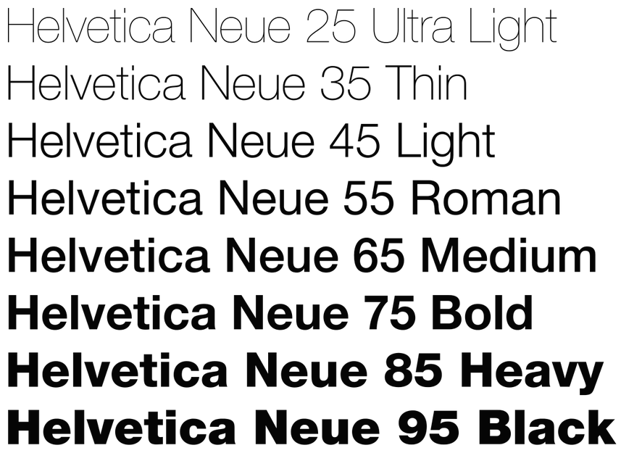
Font characteristics
Weight

Slide 18
Font characteristics
Weight
35 Extra Light
45 Light
55 Medium or Regular
65 Bold
75 Extra Bold
95 Black
6 series (italics)
46 Light italics
7 series (condensed)
57 Medium condensed
8 series (condensed italics)
68 Bold condensed italics
Helvetica 67 = Helvetica Bold condensed

Slide 19
Font characteristics
Weight
TrueType font format introduced a scale from 100 through 900, where 400 regular (roman or plain), which is also used in CSS and OpenType.
The first algorithmic description of fonts was perhaps made by Donald Knuth in his Metafont and TeX system of programs.

Slide 20
Font characteristics
Weight
If no bold weight is provided, many renders support faking a bold font by rendering the outline a second time at an offset, or just smearing it slightly at a diagonal angle.
xPression?

Slide 21
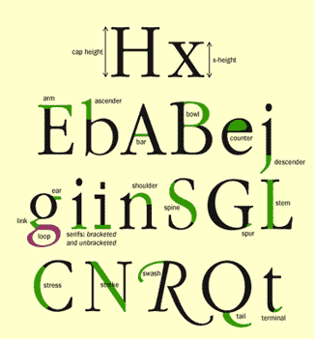
Anatomy of a Character
Arm/leg
Ascender
Bar
Bowl
Cap Height
Counter
Descender
Ear
Link
Loop
Serif
Shoulder
Spine
Spur
Stem
Stress
Stroke
Swash
Tail
Terminal
X-height

Slide 22
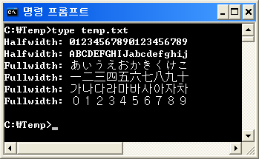
Halfwidth and fullwidth forms
全角 & 半角
半角字符 | Unicode | 全角字符 | Unicode
¥ | U+00A5 | ￥ | U+FFE5
₩ | U+20A9 | ￦ | U+FFE6

Slide 23
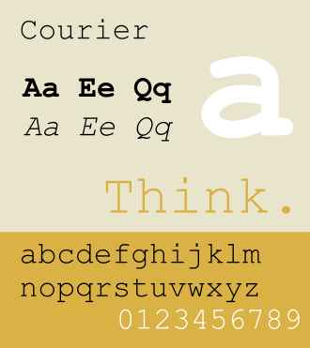
Monospaced font
Also called fixed-pitch, fixed-width, or non-proportional font.
Use in computers and computer terminals.
Use in IDEs, increases the readability of source code.

Slide 24
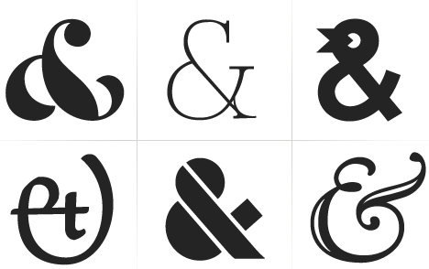
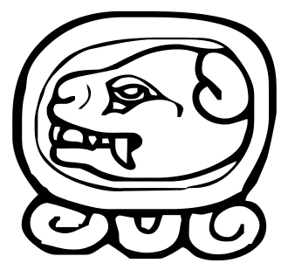
Glyph
In typography, a glyph /ˈɡlɪf/ is an elemental symbol within an agreed set of symbols, intended to represent a readable character for the purposes of writing and thereby expressing thoughts, ideas and concepts.

Slide 25
Glyph
Various glyphs representing the letter “&”
Maya glyph for Day 10 of the tzolkin calendar

Slide 26
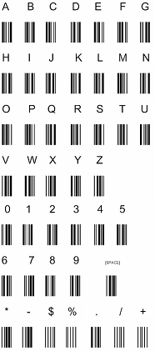
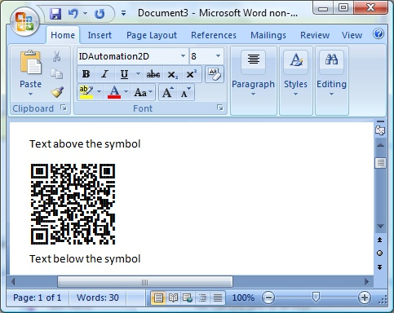
Glyph

Slide 27
Glyph

